Slide 1
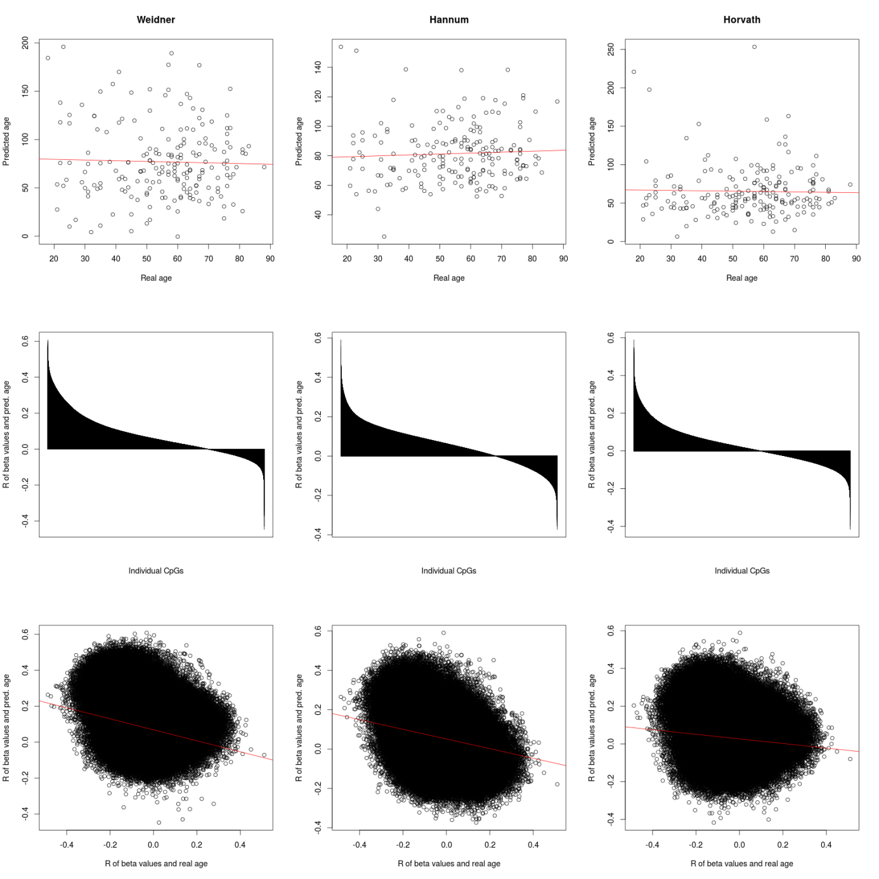
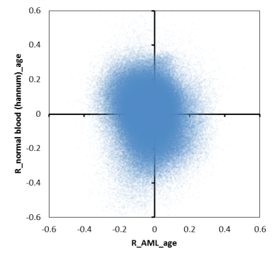
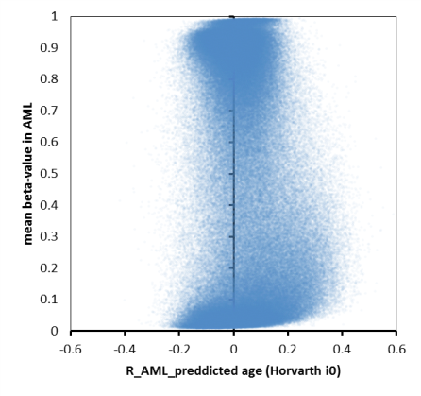
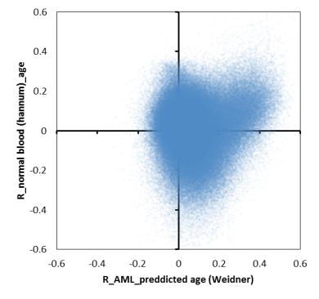
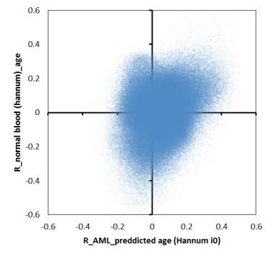
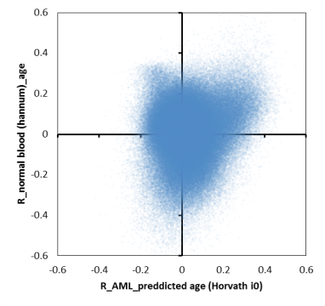
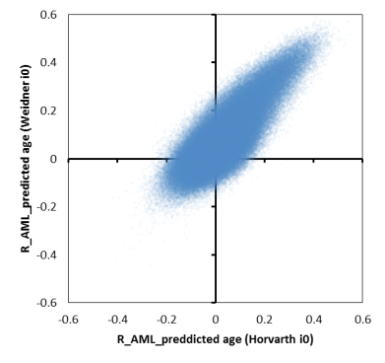
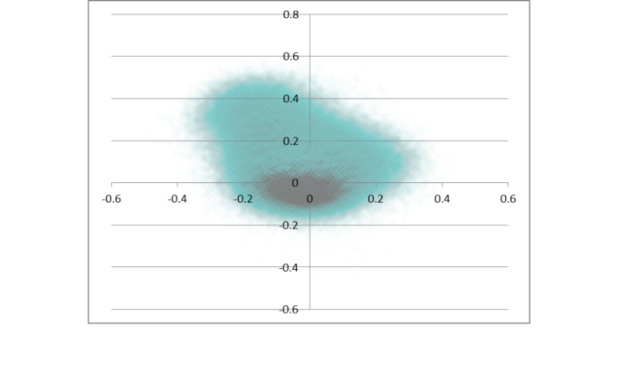

Slide 2
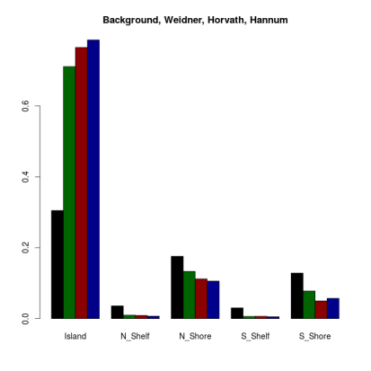
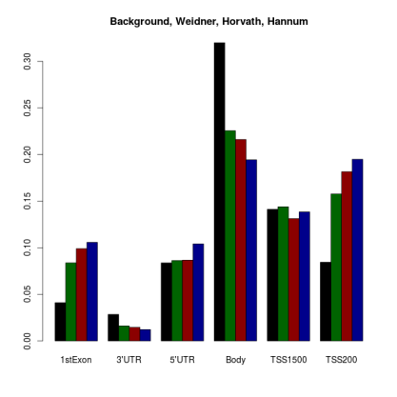
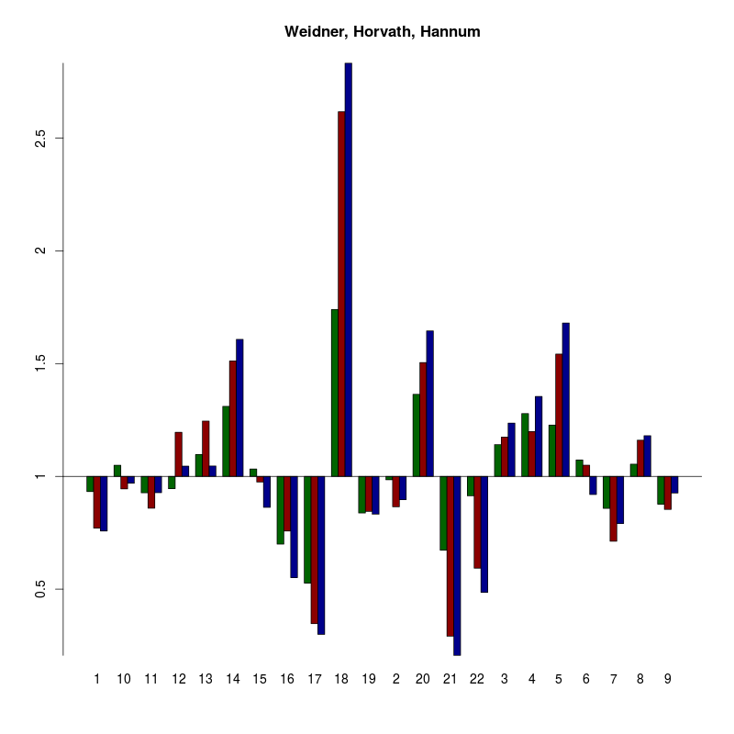
Perhaps we should also include the enrichment of normal age-associated CpGs? We need P-values. I can adjust colors in EXCEL – if you could provide the values in an table then this would help
Should we only take a treashold of R>0.4 in all three predictors – then we would have a selection of 263 CpGs for further analysis
263 CpGs
Enrichment in chromosomal regions?
Enrichment in TF binding sites
MOTIVES
Enrichment in miRNA binding sites???
Association with histone code?
Reference might be unsorted blood? Preferentially CD34+ hematopoietic stem and progenitor cells…

Slide 3
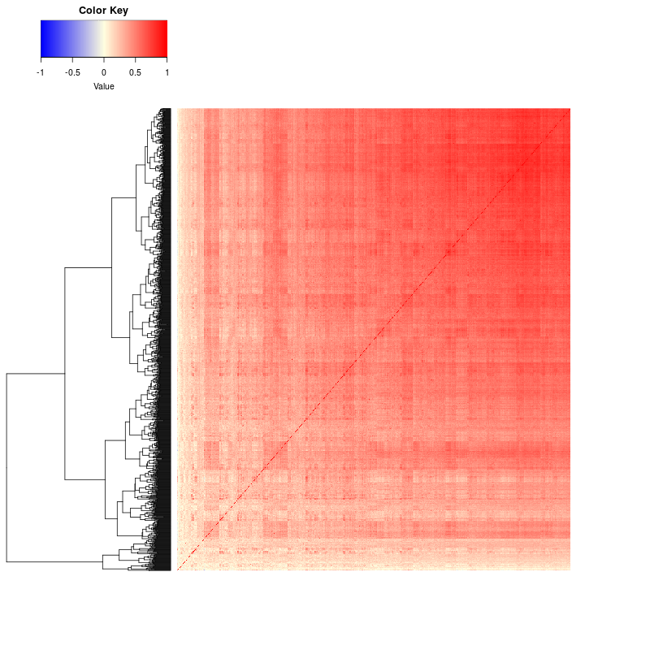
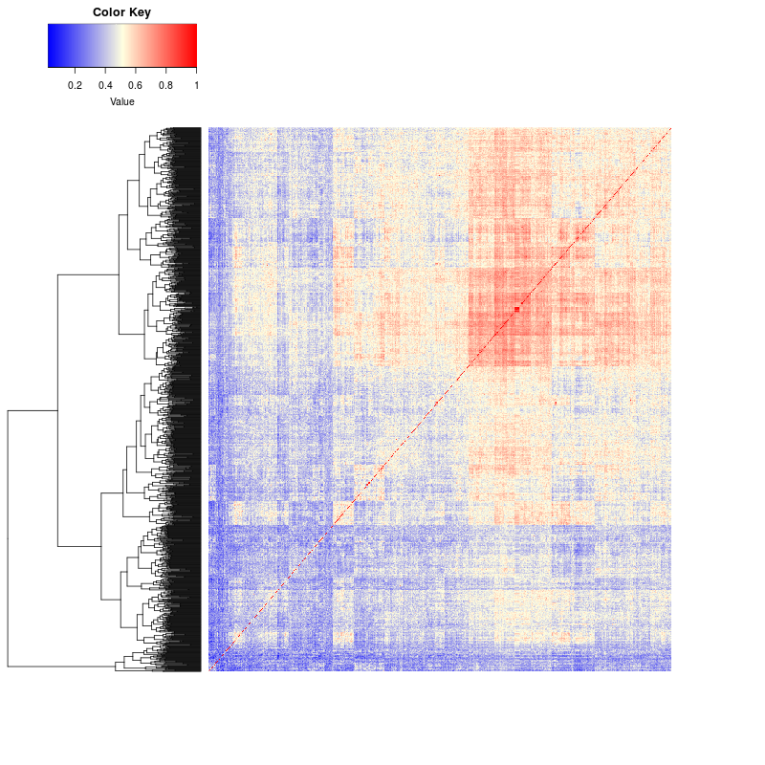
CpG vs CpG correlation comparison (using the beta values in hannum or laml). So a red cell means that the two cpgs correlate perfectly with each other; a blue cell means they inversely correlate (perfectly).

Slide 4
Alternatively: R>0.4 in all predictors and variance >0.1
CpG_ID | CHR | MAPINFO | Probe_SNPs | Probe_SNPs_10 | Methyl27_Loci | UCSC_RefGene_Name | UCSC_RefGene_Group | UCSC_CpG_Islands_Name | Relation_to_UCSC_CpG_Island | R_laml_age | R_hannum_age | Mean_laml | Variance_laml | Mean_hannum | Variance_hannum | R_weidner_i0 | R_horvath_i0 | R_hannum_i0
cg04100532 | 2 | 210636560 |  |  | NA | UNC80;UNC80 | TSS200;TSS200 | chr2:210636344-210636935 | Island | -0.16427284 | 0.20330189 | 0.32098945 | 0.10576592 | 0.11432058 | 0.0037366 | 0.49685134 | 0.54398557 | 0.42743361
cg12832313 | 5 | 140346236 |  |  | NA | PCDHAC2;PCDHAC2;PCDHA7;PCDHA12;PCDHA6;PCDHA10;PCDHA4;PCDHA11;PCDHA8;PCDHA6;PCDHA1;PCDHA2;PCDHA1;PCDHA9;PCDHA13;PCDHA5;PCDHAC1;PCDHA3;PCDHAC2;PCDHA10 | 1stExon;TSS200;Body;Body;Body;Body;Body;Body;Body;Body;Body;Body;Body;Body;Body;Body;Body;Body;5'UTR;Body | chr5:140346105-140346931 | Island | -0.27025935 | 0.15136646 | 0.36783097 | 0.10083642 | 0.07033917 | 0.00166144 | 0.42967872 | 0.4016033 | 0.4537044
cg15015920 | 5 | 16179873 |  |  | NA | MARCH11;MARCH11 | 1stExon;5'UTR | chr5:16179064-16180420 | Island | -0.12681357 | 0.38359363 | 0.40660811 | 0.10211886 | 0.07171172 | 0.00127925 | 0.48991384 | 0.41503289 | 0.55752035
cg17712694 | 5 | 16180068 |  |  | NA | MARCH11 | TSS200 | chr5:16179064-16180420 | Island | -0.13739726 | 0.26099074 | 0.53866479 | 0.10293537 | 0.09971866 | 0.0030073 | 0.4740304 | 0.4172928 | 0.47738821
cg21901718 | 5 | 16180076 |  |  | NA | MARCH11 | TSS200 | chr5:16179064-16180420 | Island | -0.18621951 | 0.15120857 | 0.37916698 | 0.10788631 | 0.02870969 | 0.0007064 | 0.49488892 | 0.42238128 | 0.46444018
cg25092681 | 5 | 16180033 |  |  | NA | MARCH11 | TSS200 | chr5:16179064-16180420 | Island | -0.16279894 | 0.22799394 | 0.33209898 | 0.10286631 | 0.02426104 | 0.00073495 | 0.46942019 | 0.41468939 | 0.5031199

Slide 5
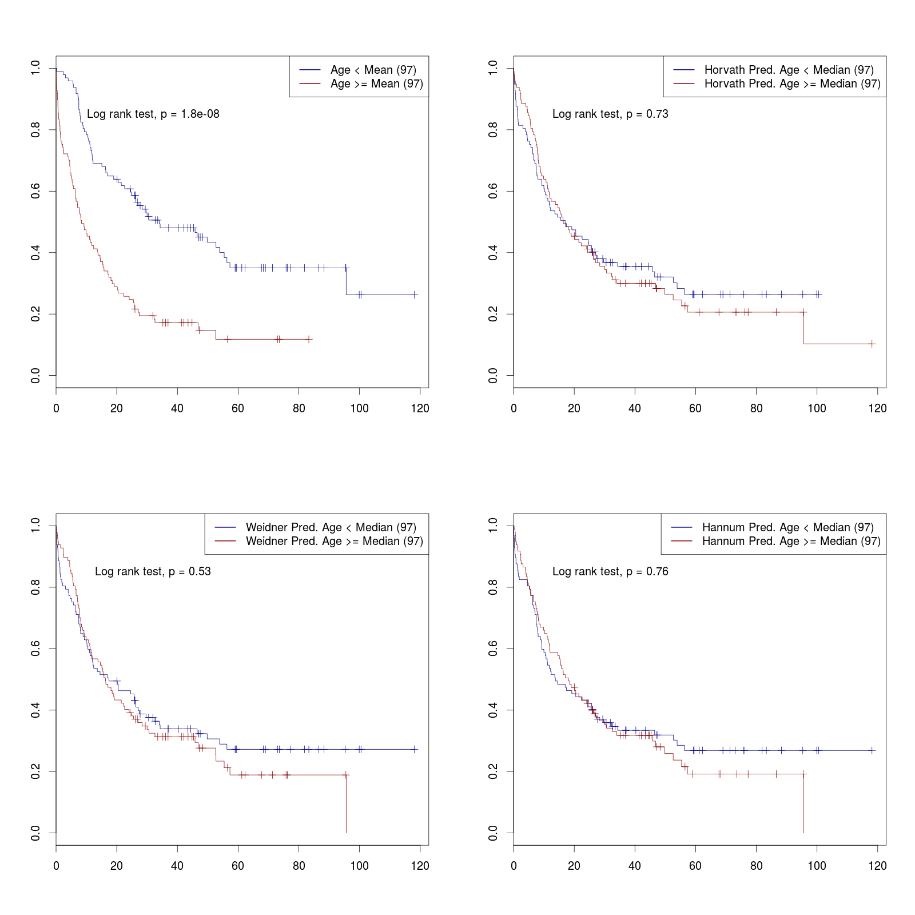
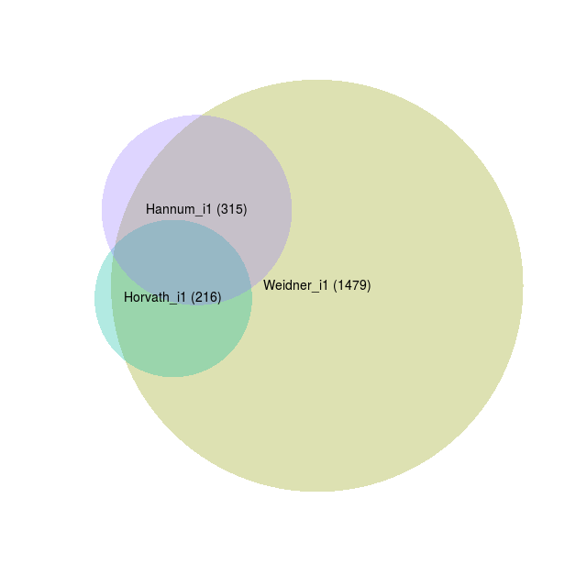
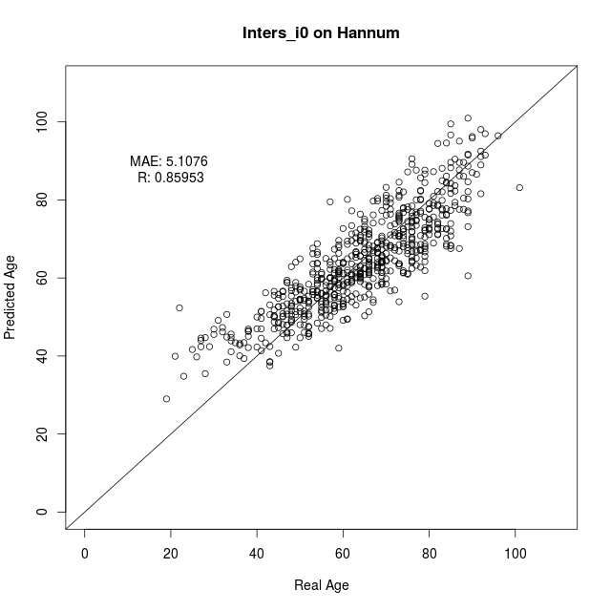
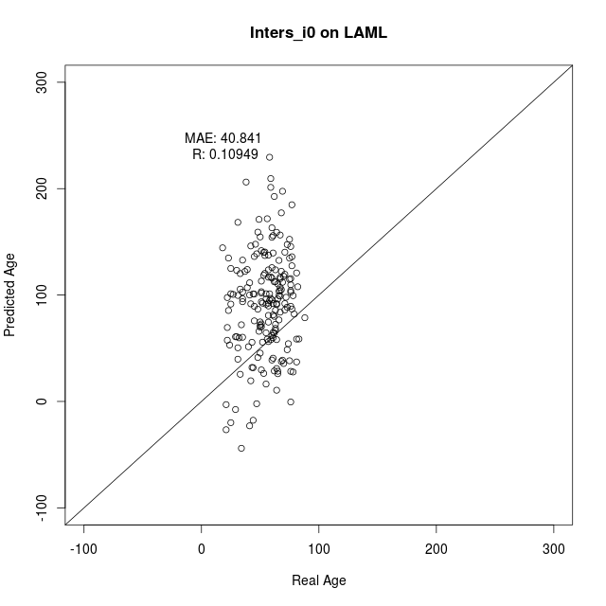
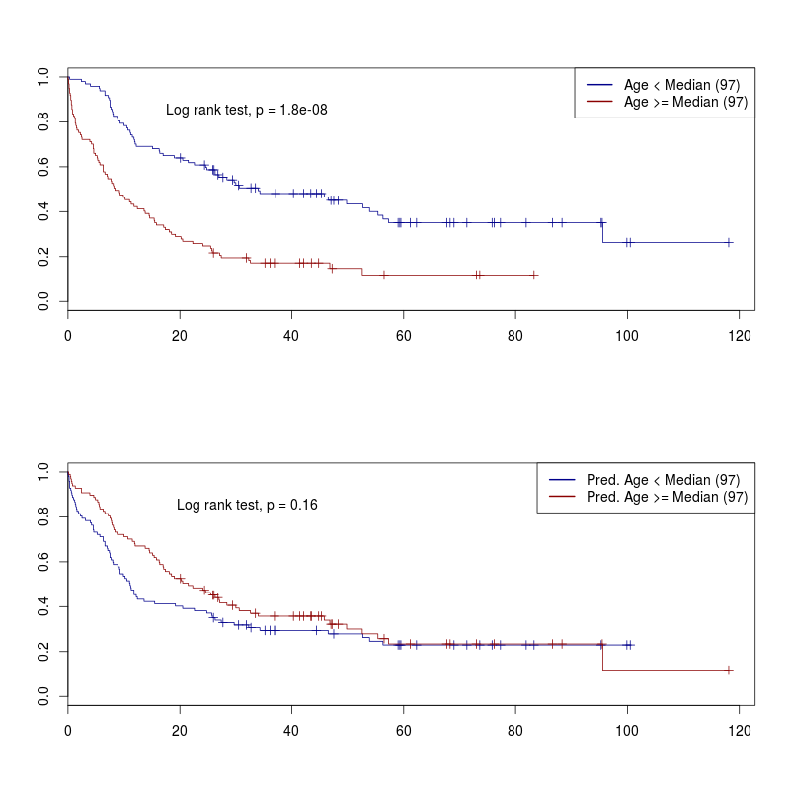
Variance filter >0.05
Correlation > 0.4
Only positive
99 CpGs in intersection of the three predictors – and all of them are exclusively positive.
These are used for retraining
… completely distinct from the Weidner 99 CpG model
Perhaps we should reduce to CpGs that are age-associated in Hannum before retraining the model?
COX Model might be informative (adjusted for age and gender)
We might also plot predicted vs. Real age in LAML using the 11 CpG Model.
More stringent filter (e.g. variance > 0.05 and correlation >0.45 – this would give 10 (11) CpGs that are applicable for MassARRAY… with the additional variance filter might be less…
Validatio n in other AML datasets:
Karolinska,
AML Halle
AML-AZA
…another on that Tanja downloaded…
?? Test signature on other tumors? Similar to table 1 in Lin and Wagner PLoS Genetics…. If then we ask Qiong
?? Perhaps we can subclone and anlayze DNAm in individual clones?? Furthermore, we can ask Monika who has analyzed individual subclones in normal CD34+ cells…

